Slide 1
RecipEat
Technology Review: Spoonacular, Edamam
Corina Geier, Jeffrey Lai, Edward Lou, Sai Muktevi & Andrew Zhou

Slide 2
Outline
Project Overview
Use Case
APIs: Spoonacular and Edamam
API Outputs
API Pros and Cons
Decision
Tech Stack

Slide 3
Project Overview
Goals:
Fast and simple to find recipes based on the ingredients you have at home
Easy to incorporate a balanced diet based on nutrient targets
Requirements:
User can login
User can keep a running list of available ingredients
User can input ingredient-based & nutrient-based inputs
RecipEat will return some recommended recipes
RecipEat will provide a visual comparison of recipes

Slide 4

Use Case
User: Max, a working dad
Objective: Max wants to make healthy recipes for his kids with the ingredients he has on hand so he doesn’t have to run to the grocery store
Action: Max logs into RecipEat and enters the ingredients he has at home, along with some nutritional targets he has for him and his kids
Result: Max receives a list of the most relevant recipes and can view a visual comparison of the two

Slide 5
APIs: Spoonacular vs. Edamam
Spoonacular
Free version allows for 150 points per day (Roughly 150 searches)
Allow for filtering based on food intolerances and desired dietary goals
Returns recipes based on ingredients based on “what’s in your fridge”
Edamam
Free version allows for 200 recipes per month
Allows for analyzing nutrients of a meal given ingredients
Can return recipes based on nutrient or ingredient inputs

Slide 6
Spoonacular Output
Returns a JSON output that is easily converted into a pandas dataframe
Based on ingredients and nutrient information will receive back a recipe with protein, calories, carbs, and fat.
A .jpg file path is also returned for a visual of the recipe

Slide 7
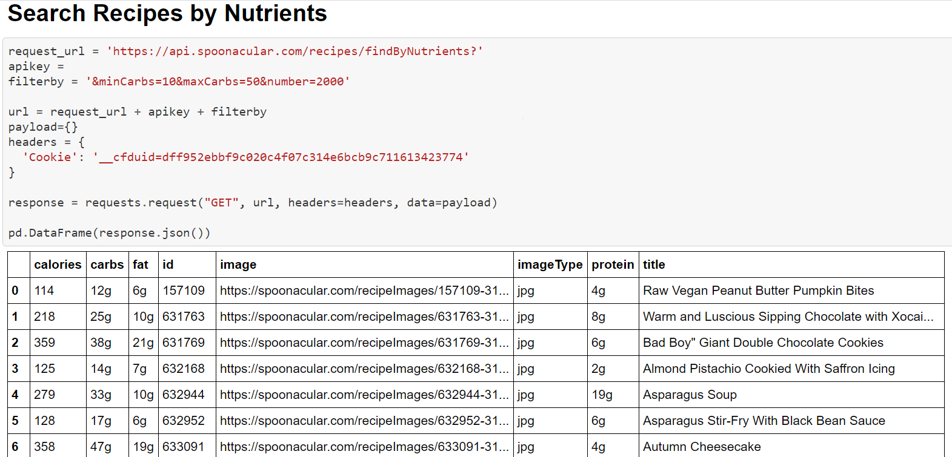
Spoonacular Response

Slide 8
Edamam Output
Returns a heavily nested JSON output that is not easily converted into a pandas dataframe
The JSON requires a lot of processing before converting to a DataFrame (JSON Normalization)
Displays link to recipes with given ingredients
Nutrition information is also returned, such as calories, sugars, and fats

Slide 9
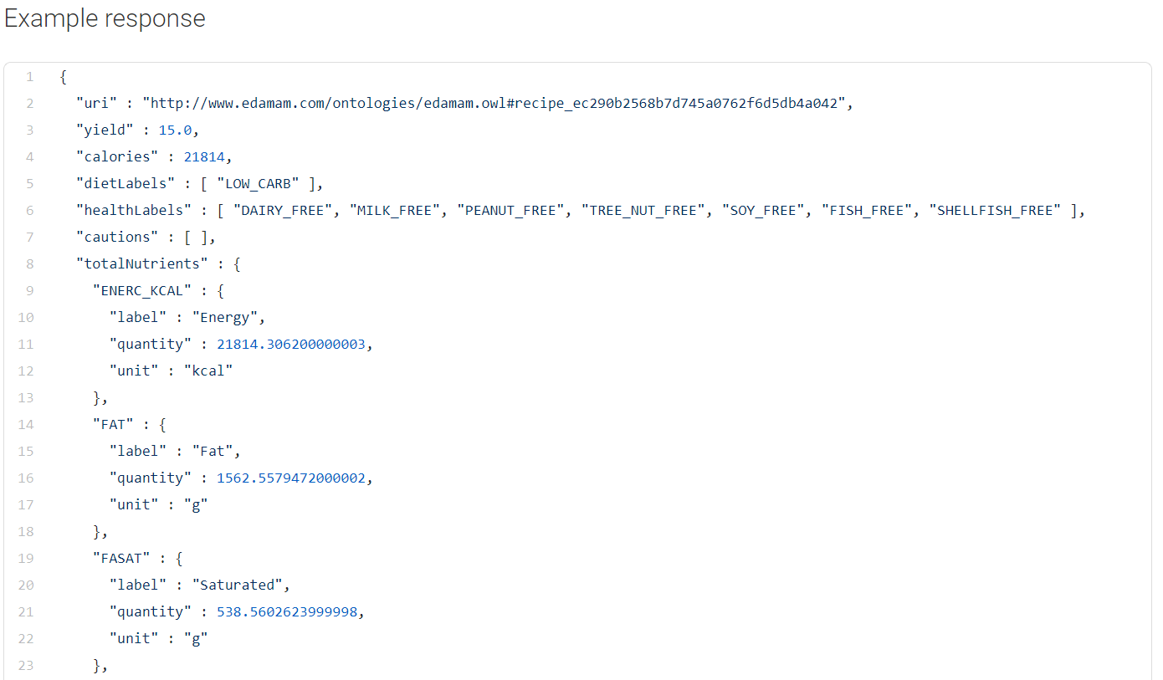
Edamam Response
GET https://api.edamam.com/api/nutrition-data?app_id=0eed04fd&app_key=cb51c2ee6467fbd470dc3b47520a32c6&ingr=1%20large%20apple

Slide 10
Spoonacular: Pros and Cons
Pros:
Well documented with extensive tutorials for support and maintenance
API is not limited to recipes, includes grocery products and menu items
Ability to search for recipes based on ingredients and nutrients using one endpoint
Extensive list of nutrition filters available to filter on
Output is easily converted into a pandas dataframe
Includes over 365,000 recipes and 86,000 food products
Cons:
Can only return a maximum of 100 recipes per search
Some API functionalities are not listed out in detail as compared to Edamam.

Slide 11
Edamam: Pros and Cons
Pros:
Has built in visualization tools for comparing recipes
Edamam extracts nutrition and ingredient data from ingredient text
Edamam returns information for calories, fats, carbohydrates, protein, cholesterol, and sodium for each ingredient or food entered
Cons:
The API is split into 3 API’s
Each has their own documentation
Documentation is not very clean or easy to read
Less ingredient and nutrient filters than Spoonacular
No commercial use
Output is a heavily nested JSON object, requiring a lot of processing to convert to a dataframe

Slide 12
Decision: Spoonacular
Edamam and Spoonacular are similar solutions but overall Spoonacular is better suited for our purposes
Spoonacular is better documented, only requires use of one API, and output is easily converted to pandas dataframe
Spoonacular fulfills all of our requirements
Keep a running list of available ingredients - “what’s in your fridge?” search
Input ingredient-based & nutrient-based inputs
Returns some recommended recipes - find similar recipes
RecipEat will provide a visual comparison of recipes

Slide 13
Tech Stack
Python
Flask
Firebase - Realtime Database
Pyrebase
HTML, CSS, Bootstrap

Slide 14
Thank you!

